Slide 1
Unit 2
What time do you
go to school?
Section B 1a-1e
七年级(下)

Slide 2
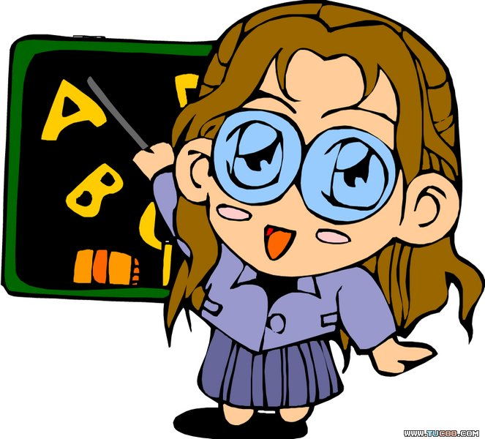
Objectives
To learn to use When questions
To learn to ask and answer When questions using adverbs of frequency To learn to listen and write the time

Slide 3


Slide 4
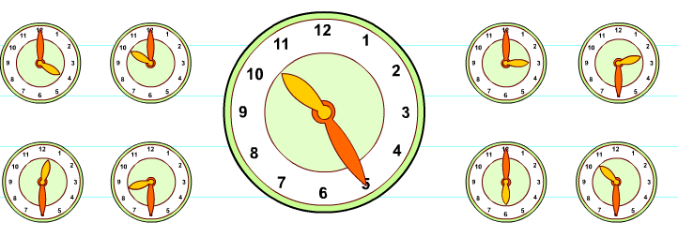
Revision
What's the time?

Slide 5
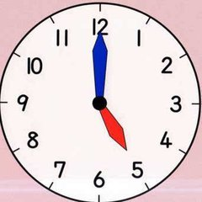
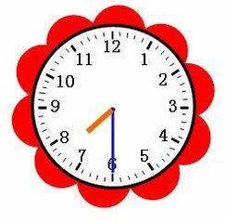
It’s five o’clock.
It’s half past seven.

Slide 6
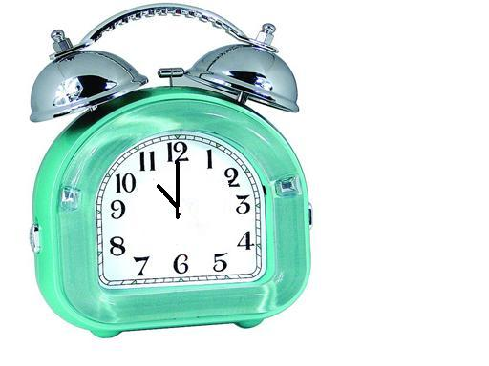

It’s eleven o’clock.
It’s half past one.

Slide 7
Ask and answer
6:15
7:30
8:00
eat breakfast
go to school
get up

Slide 8
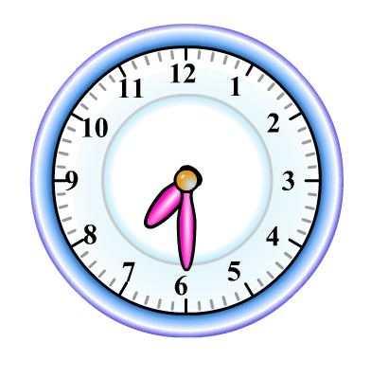
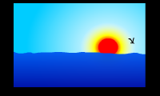
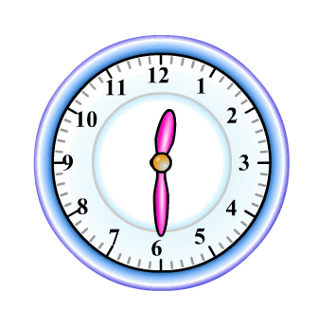
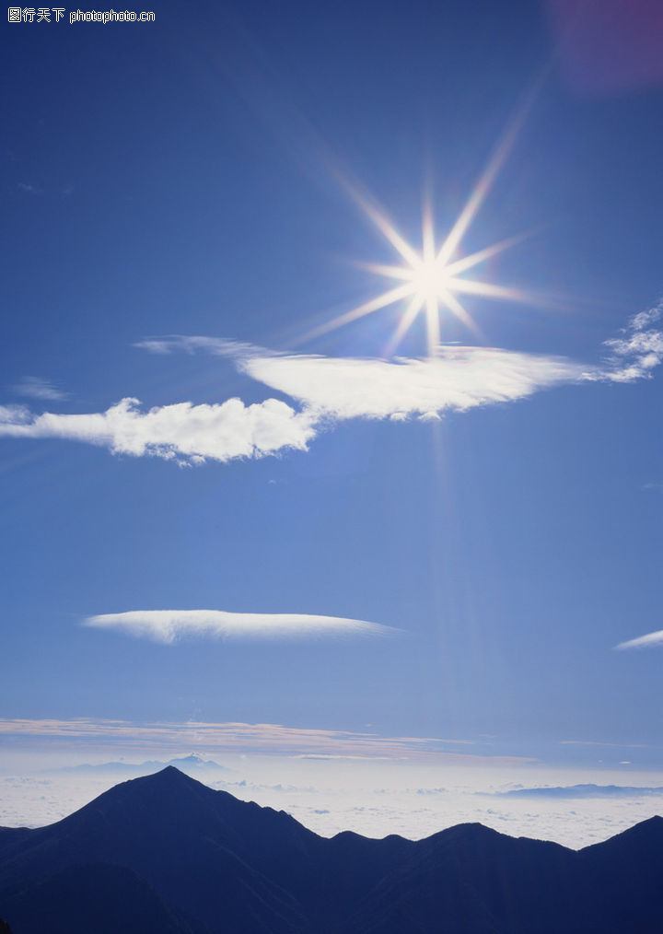
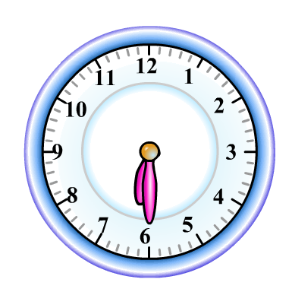
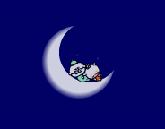
Beijing
Get to know the time of the day.
in the morning
in the afternoon
in the evening
Paris
New York

Slide 9
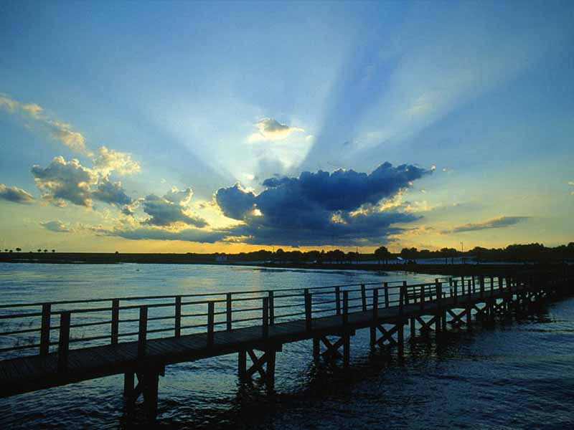
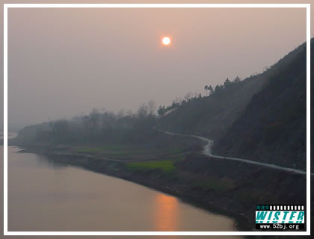
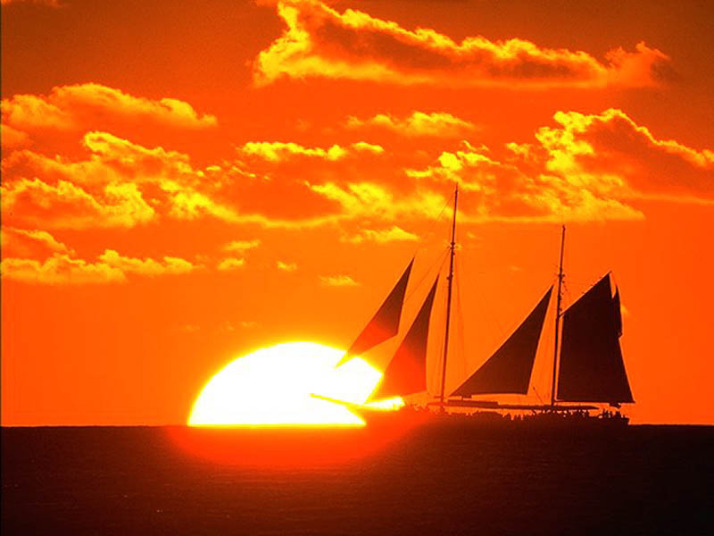
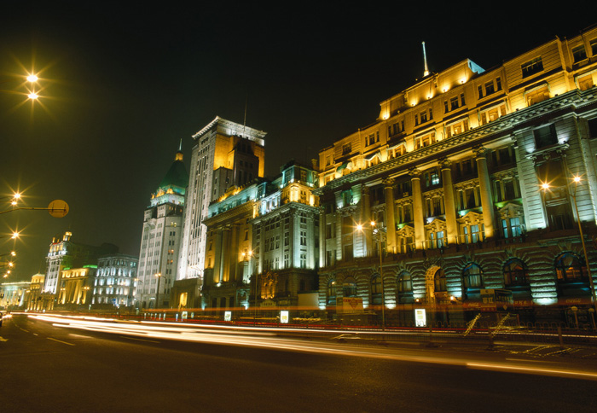
What’s the time of day?
in the morning
in the afternoon
in the evening
at night

Slide 10
Pair work
A: What do you usually do in the
morning/afternoon/evening?
B: I usually …

Slide 11
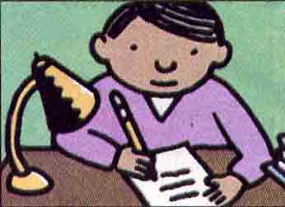
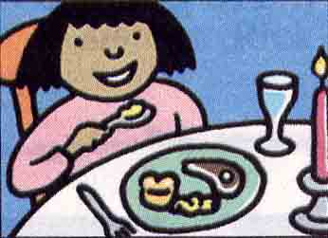
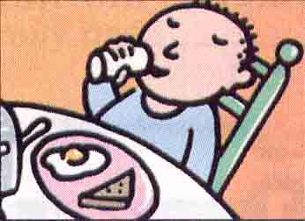
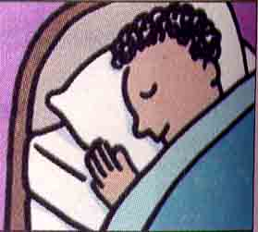
1a. When do students usually do these things? Match the activities and the time of day.
6:30 AM
half past
six in the
morning
3:15 PM
a quarter
past three
in the
afternoon
6:45 PM
a quarter
to seven
in the
evening
9:45 PM
a quarter
to ten
in the
evening
1.do homework
2.eat dinner
3.eat breakfast
4.go to bed

Slide 12
When do people usually…?
People usually ….?
do homework
eat dinner
eat breakfast
go to bed
In the morning
In the afternoon
In the evening

Slide 13
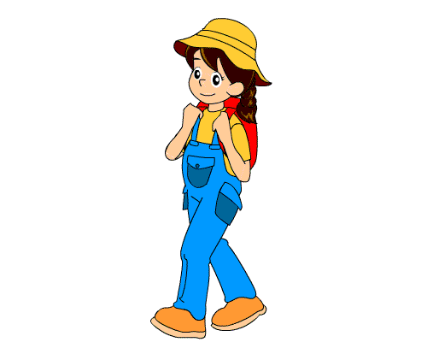
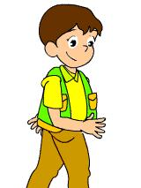
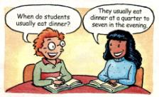
Pair work.
1b check your answers with your partner.
When do students usually eat dinner?
They usually eat
dinner at a quarter
to seven in the evening.
Check your answers!

Slide 14
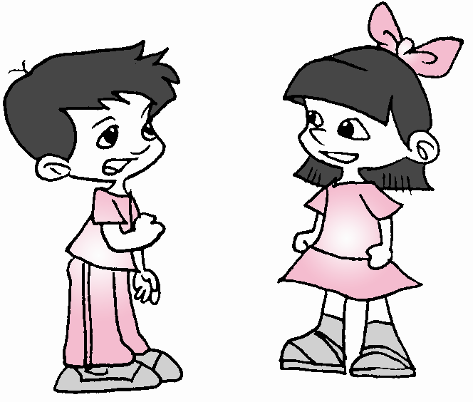


They usually eat dinner at a quarter to seven in the evening.
When do students usually eat dinner?
They usually go to bed at a quarter to ten in the evening.
When do students usually go to bed?

Slide 15


When do students eat breakfast?
They usually eat breakfast at half past six in the morning.
They usually do homework at a quarter past three in the afternoon.
When do students do homework?

Slide 16
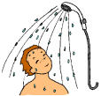


Slide 17


1c Listen and circle the activities you hear.
get up
run ____
eat breakfast ____
go to school ____
go home ________
6. do my homework ____
7. clean my room ____
8. eat dinner ____
9. take a walk ____
10. go to bed ____

Slide 18
Tom ’s daily routine
gets up | 5:30 a.m.
runs | 6:00 a.m.
has breakfast | 7:00 a.m.
goes to school | 7:45 a.m.
goes home | 4:15 p.m.
does homework | 5:30 p.m.
eats dinner | 7:15 p.m.
goes to bed | 9:00 p.m.

Slide 19
1d Listen again. Write the times next to
the activities you circled in 1c.
get up 5:30
run _______
eat breakfast ______
go to school _______
go home ________
6.do my homework
_______
7. clean my room ______
8. eat dinner ____
9. take a walk ____
10. go to bed ________
5:30 pm
6:00 am
7:00 am
7:15 pm
7:45 am
4:15 pm
9:00 pm

Slide 20
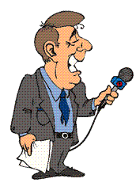
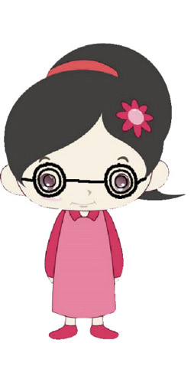
Pair work
1e Ask and answer questions about Tom.
When does Tom usually get up?
He usually gets up at half past five.

Slide 21
Quiz

Slide 22

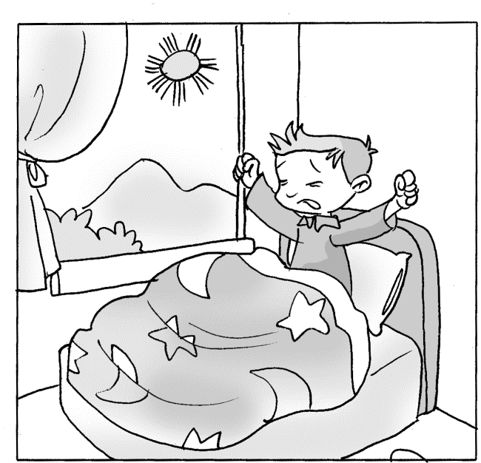

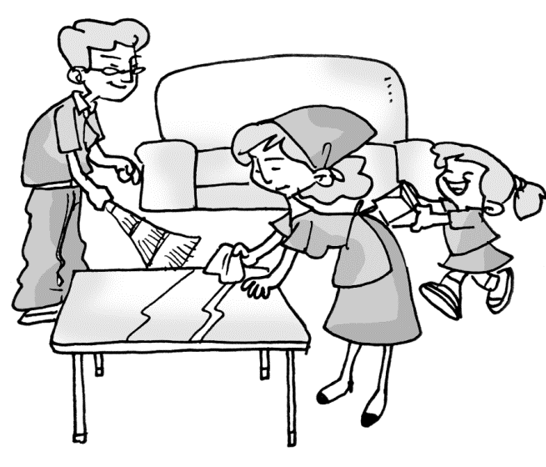
一、看图补全对话。
1. A: When does Jim ___ ___?
B: He usually ____ up at
____ ____ ____.
2. A: When do your parents
_____ ___ _____?
B: They usually _____the
room at __ ______ _____
eight in the ________.
get up
gets
half past six
clean the room
clean
a quarter past
morning

Slide 23

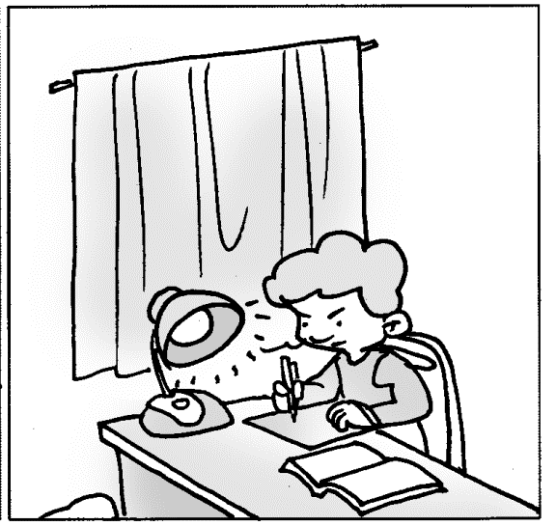

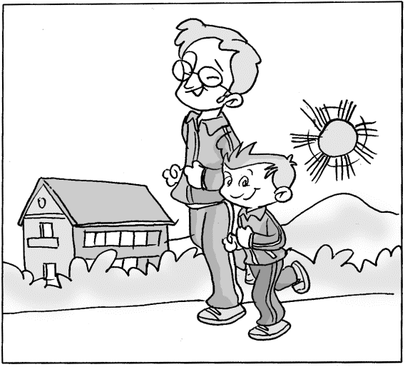
3. A: When does Jim
______________?
B: He usually ____ his _________ at __ ______ __ eight in the _______.
4. A: When does Eric ____ _
____?
B: He usually _____ a walk
at a _______ __ __ in the
_________.
do his homework
does
homework
a quarter to
evening
take a
walk
takes
quarter to six
afternoon

Slide 24
二、请用at, in 或 on 填空。
at
Her mother gets up ____ five-thirty
every morning.
2. People usually eat breakfast ____ the
morning.
3. They will go swimming ____ four ____
the afternoon.
4. I play soccer ____ Sunday afternoon.
5. Her birthday party is _____ March 8th.
in
at
in
on
on

Slide 25
三、根据中文提示完成句子：
1. 你通常什么时候洗澡?
_____ _____ do you usually _____ a shower?
2. 他通常什么时候去上学?
______ ______ he usually ____ ____ _______?
3. 她每天下午5点回家。
She ______ ______ _____ 5:00 ___ the
afternoon.
What time
take
When does
go to school
goes home at
in

Slide 26
4. 我父母通常早上8点钟去工作。
My parents usually _____ ____ work
____ 8 o’clock ____ the morning.
5. 我的小黑狗每天晚上9点睡觉。
My little black dog _____ ____ _____
at nine every night.
6. 谢谢你的来信。
Thanks _____ _____ letter.
go to
at
in
goes to bed
for your

Slide 27
7. 我每天在7: 15吃早餐。
I eat breakfast at ___ ________ past seven.
8. 大约8点钟我的小弟弟起床。
At ________ 8 ________ my little brother
_____ up.
9. 下学后, 我做作业。
______ school, I ____ ____ ____________.
10. 在晚餐之前，我看电视。
_______ dinner, I ______ TV.
a quarter
around
o’clock
gets
After
do my homework
Before
watch

Slide 28
Homework
Suppose you have a pen pal in the USA. Write something about your day to him/her.

Slide 29
写信开头用语:
Thank you for your letter.
Do you want to know about my…?
结束语:
Please write and tell me about your…
Please write soon.
签名处:
love/love from/Best wishes, Tom.

Slide 30
Thank You!

